Slide 1
What are virtual machines?

Slide 2
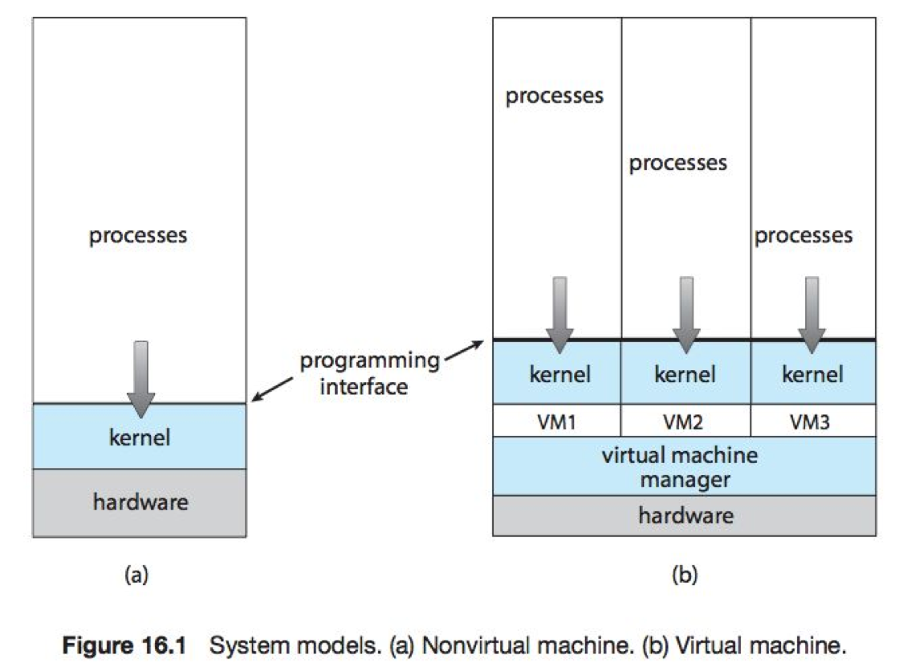
What are Virtual Machines?

Slide 3
What are virtual machines?
At the base is the host, underlying hardware
Virtual machine manager (VMM)
Also known as the hypervisor
Creates and runs virtual machines
Provides an interface that is identical to the host (except in the case of paravirtualization)
Usually guest is an operating system
Configure resources available to each guest operating system E.g. two virtual CPUs, 4GB of RAM, 10GB of disk, etc.

Slide 4
Why Virtual Machines are Useful on the Cloud?
Protection due to isolation
Host systems is protected against virus, security breaches and bugs in guest operating system applications
One guest operating system is protected from another guest operating system
E.g. Two guest operating systems can run on the same hardware yet not be able to read information from the each other. Thereby achieving security.
Flexibility
Suspend and resume virtual machine
Snapshot of virtual machine state
Can be used to allow restoring to previous state
Allow virtual machine to be cloned.

Slide 5
Why Virtual Machines are Useful on the Cloud?
Consolidation of resources
Many lightly used systems can be combined to create one more heavily used system
Cheaper to manage
E.g. 100 physical servers running 20 virtual servers equals 2000 virtual servers.
Many people needed to administer 2000 real servers but one or two can manage 2000 virtual servers
A useful tool is templating
One standard virtual machine image is used for multiple virtual machines

Slide 6
Why Virtual Machines are Useful on the Cloud?
Live migration
Moves a running guest from one physical machine to another.
Useful when system is overloaded for load balancing
Useful when hardware is to be upgraded or repaired
Install all software and configuration settings on a virtual machine image.
Makes redeployment of operating system and environment much faster.

